Slide 1
Low Cost High Accuracy Spectral Test System
Advisor/Client: Dr. Degang Chen
Team Members: Scott Poder, Yifan Jiang, Tao Chen

Slide 2
Problem Statement: Dynamic Spectral Testing
Standard Test Requirements
Spectral purity of input signal to be at least 3 to 4 bits more pure than ADC under test
The input signal range should be only slightly lower than the ADC input range
The signal should be sampled coherently
Defect
Time consuming
Very expensive
Difficult to set up the test, maintain, and calibrate
=

Slide 3
Conceptual Sketch: New Algorithm
Improvement
Dramatically reduce the purity requirement
Completely remove the need for coherent sampling
Allows for the signal to be clipped up to 1%
Achievement
With this new algorithm, we are able to design a PCB test system for very low-cost, high-accuracy spectrum test for high performance ADCs.
=

Slide 4
Functional Requirements
Deliver Accurate Spectral Test using the new algorithms
THD ±1dB compared to Traditional Test Method
Should not be Time Consuming to obtain results
Should be completely controllable by the user through a PC
Digital Switching in the form of Relays (no physical switches)

Slide 5
Non-Functional Requirements
Low Cost in Comparison to the Traditional Spectral Test
Traditional Test Method Cost: $28,300
New Test Method Cost: Under $500

Slide 6
Audio Precision
Test Board
RR Filter
DAC
Buffer
Buffer
ADC
RC Filter
Memory
Lookup table
FPGA
Memory
Data storage
PC

Slide 7
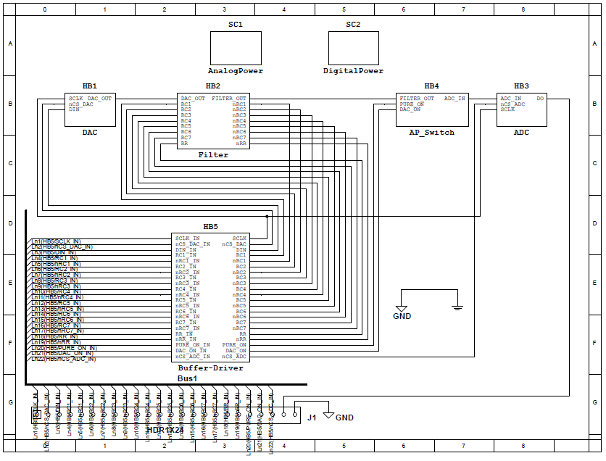

Slide 8
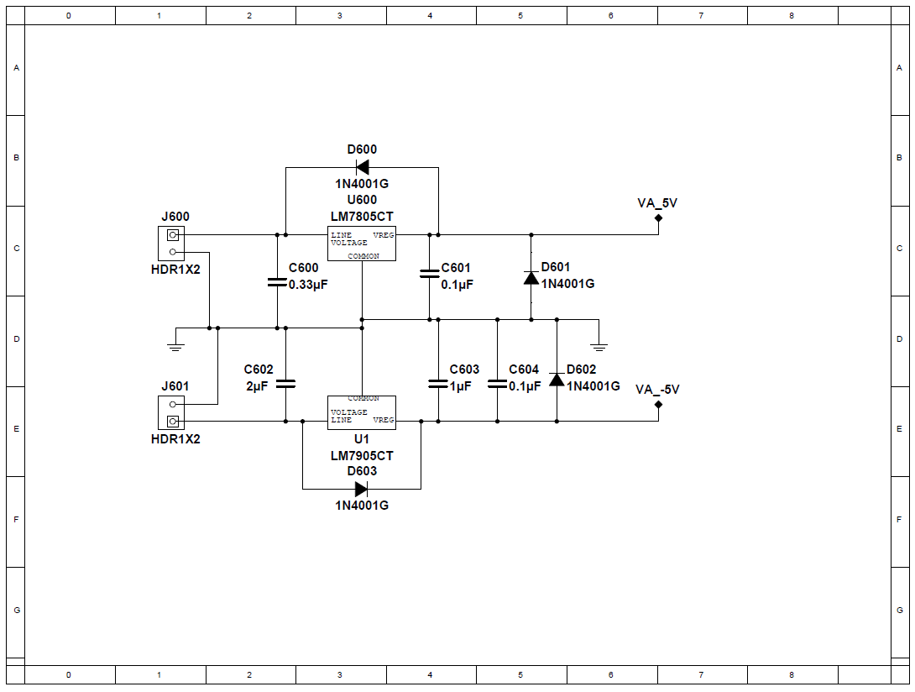

Slide 9
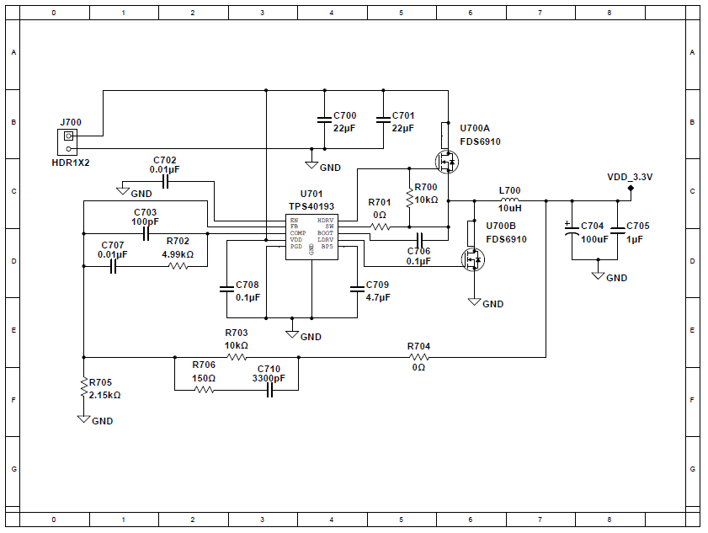

Slide 10
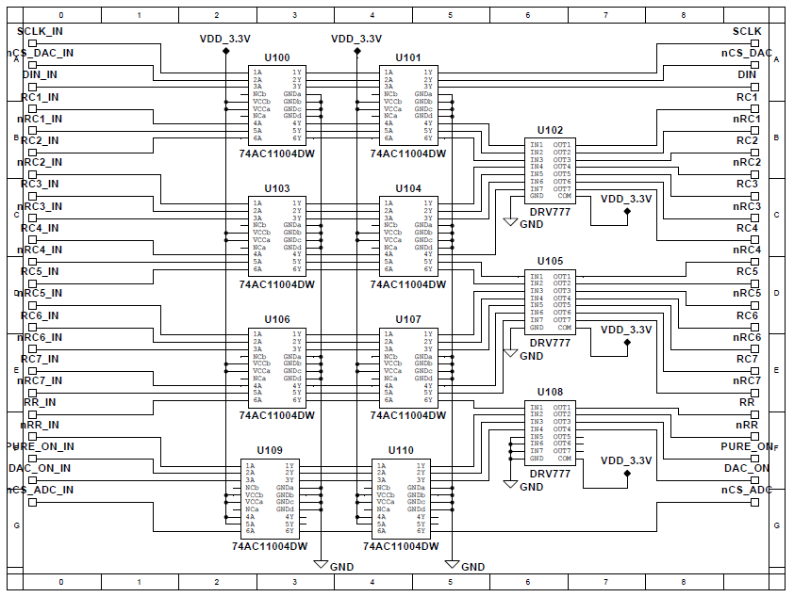

Slide 11
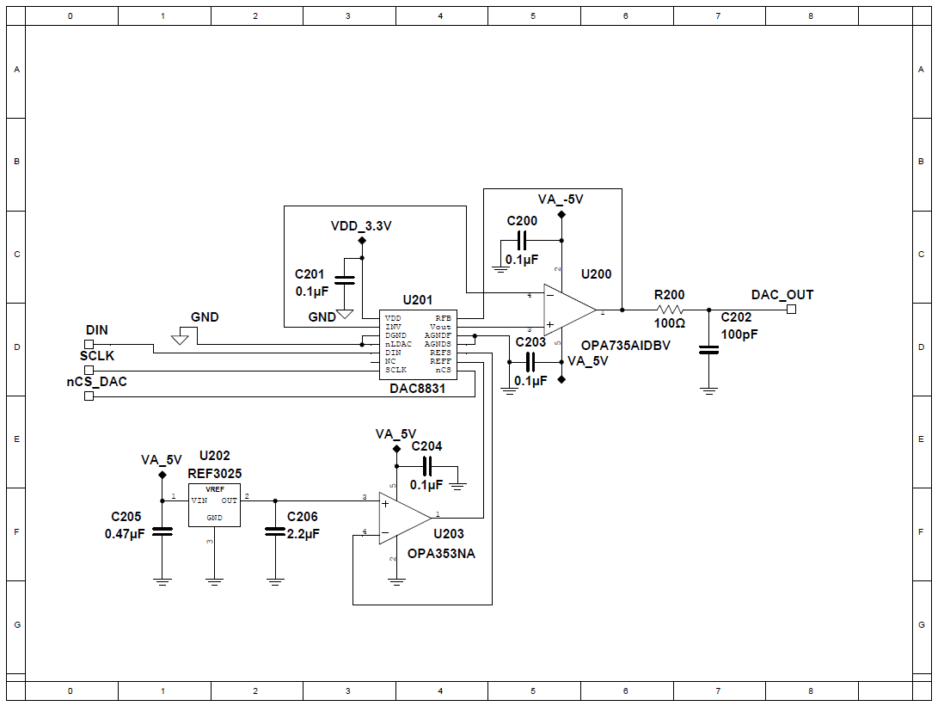

Slide 12
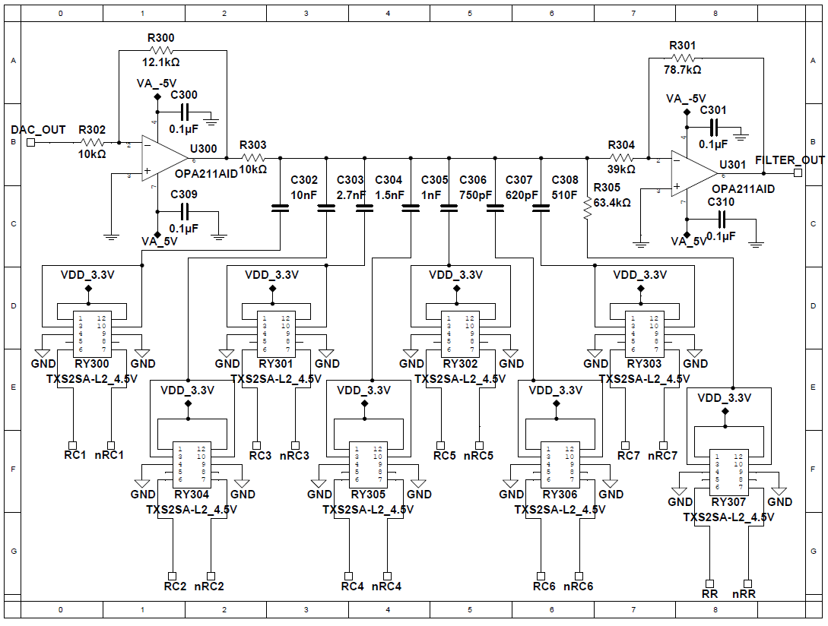

Slide 13
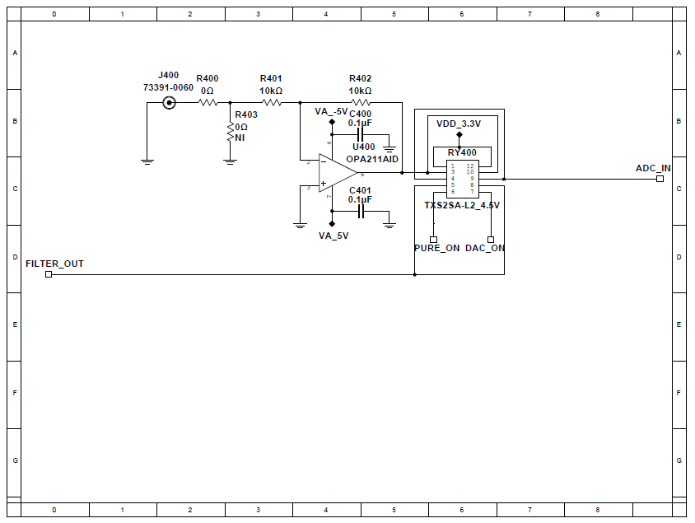

Slide 14
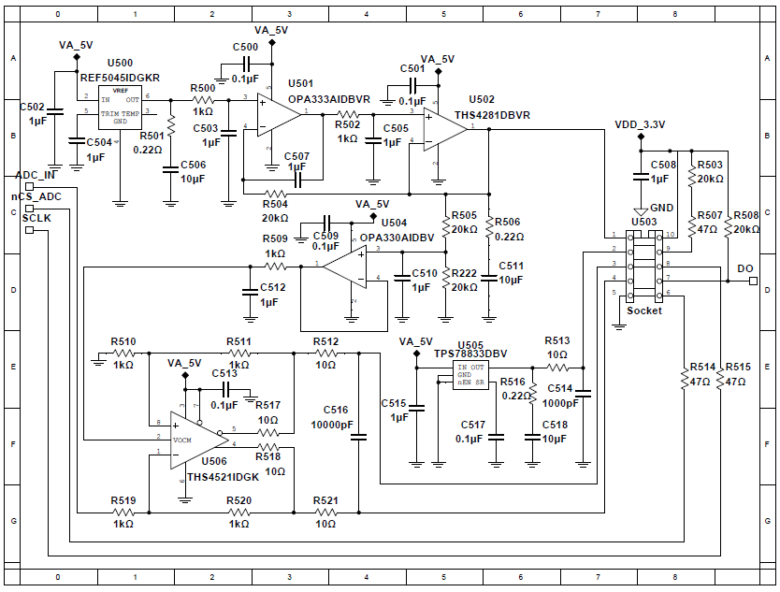

Slide 15
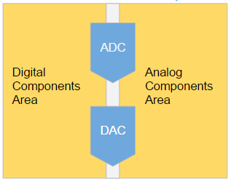
PCB Approach
Four Layer Board
Layer 1: Components and Routing
Layer 2: Ground Layer
Layer 3: Power Plane Layer
Layer 4: More Components and Routing
Separate Analog and Digital Components

Slide 16
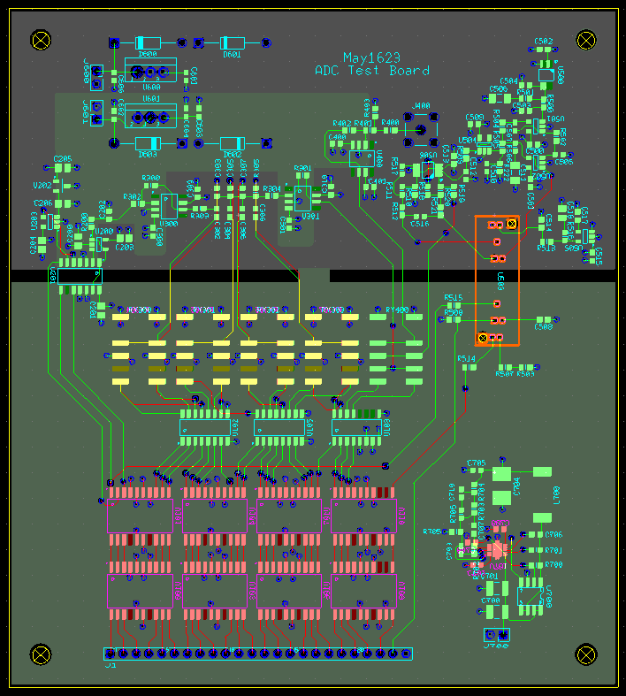

Slide 17
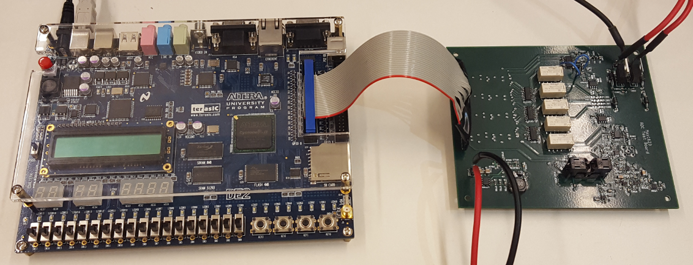
The Finished Product

Slide 18
Low Cost
PCB Fabrication: $66.00 Electrical Components from Digikey: $247.80 ADC Socket: $11.00 FPGA: Free (Lent from ISU Parts Shop)
Total: $324.80
APx555: $28,300

Slide 19
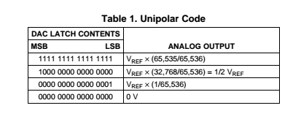
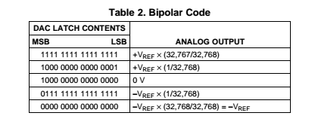
Sine Lookup Table
Two Operation Models for DAC8831
Unipolar Output vs Bipolar output

Slide 20
Sine Lookup Table
Important parameters
f_target : target frequency - We will test our ADC at multiple frequency
M: Lookup Table Size - We choose M = 2^16
J(i): i-th element in Lookup Table
* Our target frequency is 6.89kHz,13.78kHz,20.3kHz. Also, the ratio between f_target and ADC sampling rate should be non-integer.

Slide 21
Sine Lookup Table
We choose Bipolar Operation model.
The range of V_out = +/- 2.5 V
But we told by Dr.Chen, do not test at 100% of V_ref.
So we choose 99% of V_ref
Formula for D(i) :
D(i)= round((1+2*0.99*sin(2*pi*((f_target/sampling rate*M)/65536)*k))*16384+16384)

Slide 22
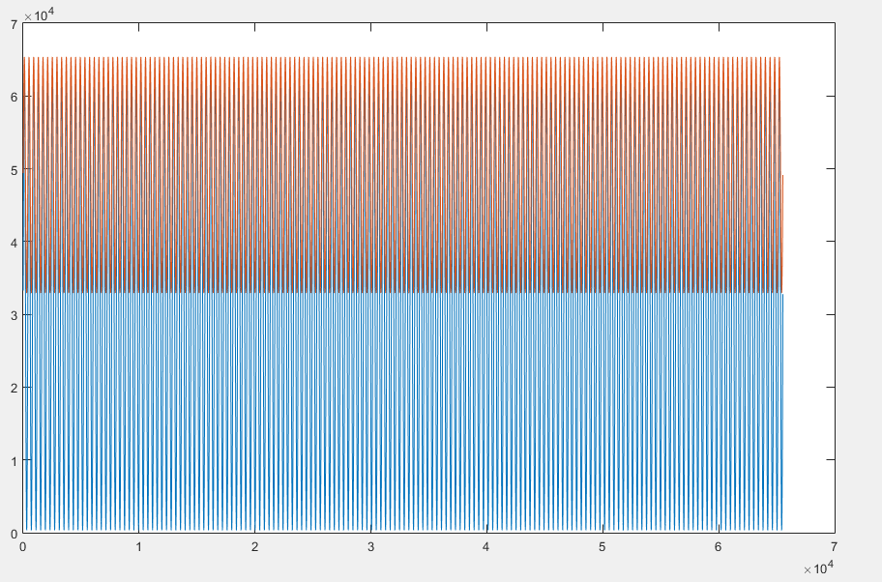
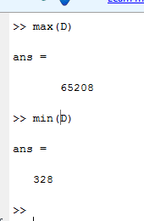
Sine Lookup Table
Check the results:
The maximum D returns
V_out(max) = 2.5*(65208-2^15)/(2^15) = 2.4749
And the minimum D:
V_out(min) = 2.5*(328-2^15)/(2^15)= -2.4749

Slide 23
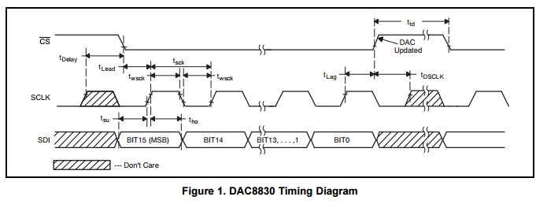
DAC8831 Timing Diagram
SDI: serial data input
Ttd: 30 ns, cs high between active period

Slide 24
ADS 8881 Timing diagram
Tconv-max: conversion time, 500ns - 700ns
Tacq: acquisition time, minimum 290 ns
DIN: digital input

Slide 25
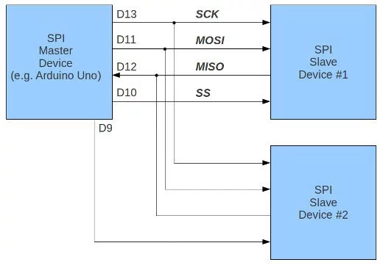
Chip programming
FPGA

Slide 26
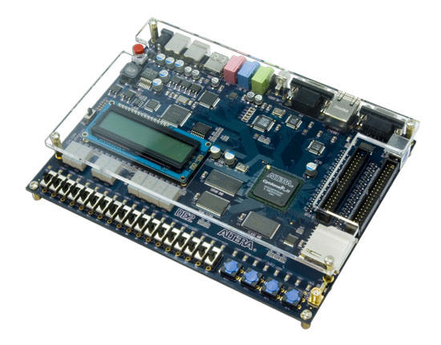
FPGA
50MHz on the board clock divides down to 8.5kHz
GPIO pins used as input/ output pins
Verilog programming

Slide 27
ADC/ DAC Simulation

Slide 28
DAC SPI Measurement from FPGA
16'b1010100100000001

Slide 29
DAC Measurement
At first: Discovered we routed INV and RFB pins together (should be separated) Solution: Took Exacto-Knife to wire traces and fixed it using jumper wire Problem Still Existed, DAC must be damaged, ordered new one Received a new one: Problem still exists

Slide 30
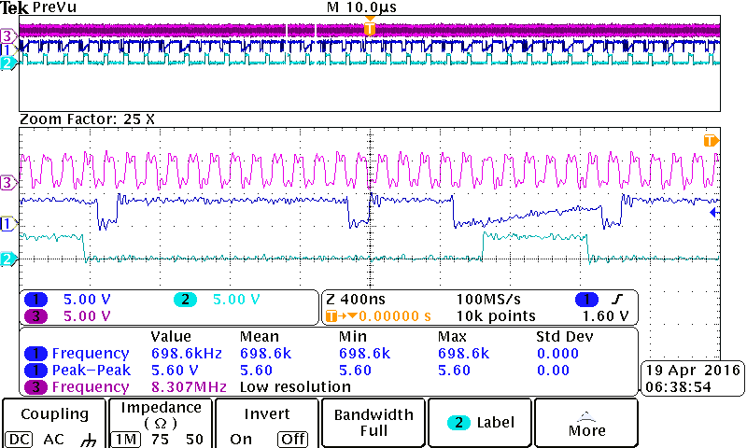
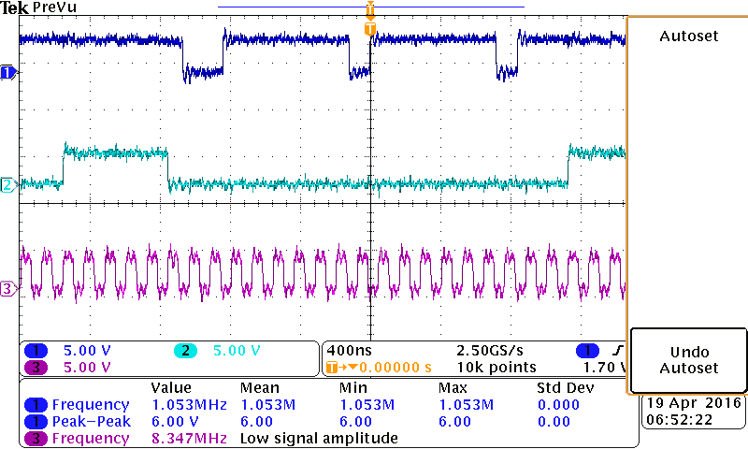
ADC Measurement
Input Voltage | Measured Output Code | Expected Code
0 | 11 1111 1111 1011 1100 | 11 1111 1111 1111 1111
4.5V | 01 1111 1011 1111 0111 | 01 1111 1111 1111 1111

Slide 31
Future Tasks: Next Year’s Senior Design Team
Either Fix DAC or Pick a new one and Redesign
Debug ADC Clock Delay Issue
Finish programming on the FPGA
Perform Spectral Test
Compare Traditional with Nontraditional
Create user friendly GUI for entire process
Make Improvements where they see fit

Slide 32
Questions?
Thanks for listening!

Slide 33
References
Ben’s Master Thesis:
Magstadt, Benjamin Thomas, “Relaxing the requirements for accurate testing of data converters” (2014). Graduate Theses and Dissertations. Paper 13918.
2. DAC8831 Datasheet:
"16-Bit, Ultra-Low Power, Voltage-Output Digital-to-Analog Converters." Texas Instruments. Texas Instruments Incorporated, Sept. 2007. Web. 26 Apr. 2016. <http://www.ti.com.cn/cn/lit/ds/symlink/dac8831.pdf>.
3. ADS8881 Datasheet:
"ADS8881x 18-Bit, 1-MSPS, Serial Interface, MicroPower, Miniature, True-Differential Input, SAR Analog-to-Digital Converter." Texas Instruments. Texas Instruments Incorporated, Aug. 2015. Web. 26 Apr. 2016. <http://www.ti.com/lit/ds/symlink/ads8881.pdf>.

Slide 34
Schedule
9/2015 - 10/2015 - Research/Component Selection/Methods 11/2015 - 12/2015 - First Draft Schematic/Simulations 1/2016 - 3/2016 - Hardware Redesign/Correct Semester 1 Errors/Begin Software 3/2016 - 4/2016 - PCB Manufacture/Testing/Documentation

Slide 35
Hardware Design
DAC
DAC8831 is 16-bit, 2MSPS, and operating in bipolar mode
Filter Design:
RC Filter - Phase Shift Output
RR Filter - Match Amplitude of RC Filter
Input from DAC: ±2.5V sine wave
Output to ADC: ±4.3V sine wave
Gain from Input to Output: 1.72
RC Filter and RR Filter: sqrt(2) attenuation at -3dB
Adjusted Gain: 1.72*sqrt(2)
7 RC Filters + 1RR Filter = 7 Possible Test Frequencies
ADC
ADC8881 is 18-bit, 1MSPS, and operating in single ended signal configuration

Slide 36
Hardware Design
RR Filter
Buffer
Buffer
RC Filter

Slide 37
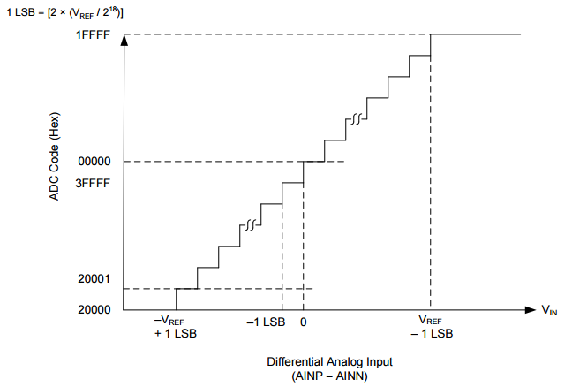
ADC Conversion Chart

Slide 38
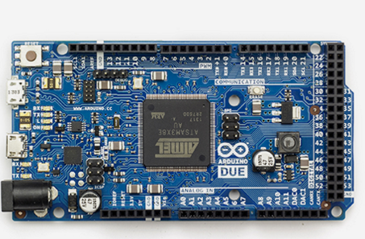
Arduino’s Internal ADC
Arduino Due
32-bit ARM core microcontroller.

Slide 39
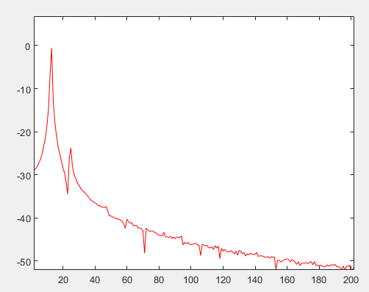
Arduino Due ADC Spectrum
F_sampling= 5kHz
F_signal = 63Hz

Slide 40
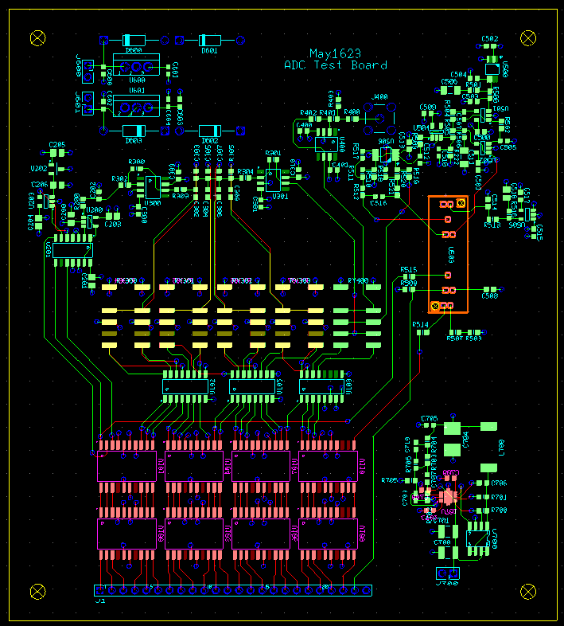

Slide 41
