Slide 1
LOW-COST-HIGH-ACCURACY SPECTRAL TEST SYSTEM
May1623
Advisor/Client : Dr. Degang Chen
Team Members: Tao Chen, Scott Poder, Yifan Jiang,
Notes:
title, team, advisor, and client info

Slide 2
Project Plan
Problem Statement
Conceptual Sketch
Functional/Non-functional Requirements
Market Survey
Potential Risks
Cost Estimate
Project Milestones
Potential Risks
May 1623 - Low-Cost High-Accuracy Spectral Test System
Project Plan
System Design
Conclusion

Slide 3
Problem Statement
Dynamic Spectral Testing
Standard Test Requirements
Spectral purity of input signal to be at least 3 to 4 bits more pure than ADC under test
The input signal range should be only slightly lower than the ADC input range
The signal should be sampled coherently
Defect
Time consuming.
Very expensive.
Difficult to set up the test, maintain and calibrate.
May 1623 - Low-Cost High-Accuracy Spectral Test System
Project Plan
System Design
Conclusion
Notes:
In real world, most data is characterized by analog signals, we need to convert that analog signals to digital signals, so that the microprocessor would be able to read understand and manipulate the data. analog to digital convertes are becoming increasingly common in integrated circuits.
In order to test ADC’s performance, we need to run an accurate spectral test. which according to IEEE standards, requires linearity of input signal, exact coherency in sampling, and tolerable jetter in the clock signal. those requirements make normal spectral test expensive.
The standard test requires that the input signal linearity be at least 20dB more pure than the ADC under test, in our case, the ADS8881 is less than -110db THD, means the standard test require the input sine wave be at least -130 db.
Input signal must be very close to the full input range of the ADC under test but to never over range since over ranging causes output clipping.
the goal of this project is to develop a prototype test system for extremely cost-effective spectral test. a recently published spectral test algorithms is proveded, this algorithms can dramatically relaxing the stringent requirements. the ADC we used is ADS8881, it is an 18-bit ADC provided by Texas Instruments

Slide 4
Conceptual Sketch
New Algorithm
The new algorithm is provided by Dr.Chen
Improvement
Dramatically reduce the purity requirement.
Completely remove the need for coherent sampling.
Allows for the signal to be clipped up to 1%
Achievement
With this new algorithm, we are able to design a PCB test system for very low-cost, high-accuracy spectrum test for high performance ADCs.
May 1623 - Low-Cost High-Accuracy Spectral Test System
Project Plan
System Design
Conclusion
Notes:
the algorithm introduction
if you interested in the new algorithm, you can read the paper from Benjamin Thomas. called Relaxing the requirements for accurate spectral testing of data converters published in 2014. ben is the former graduate student from Dr.Chen.

Slide 5
Conceptual Sketch
Audio Precision
Test Board
RR Filter
DAC
Buffer
Buffer
ADC
RC Filter
Memory
Lookup table
FPGA
Memory
Data storage
PC
May 1623 - Low-Cost High-Accuracy Spectral Test System
Project Plan
System Design
Conclusion
Notes:
We will use fpga’s memory to build up a sine wave lookup table, feed the digital signal to DAC, the DAC will give us an analog signal, which are much less linear than the standard spectual test requirement.
this analog signal will go through two different filter, than feed to ADC one by one. we collect the data from ADC, use our new algorithm to do our test..

Slide 6
Functional Requirements
Deliver accurate spectral test
Comparable to spectral test results from standard method
Completely Controllable by the user through the PC
Non-Functional Requirement
Low Cost (Budget $200)
May 1623 - Low-Cost High-Accuracy Spectral Test System
Project Plan
System Design
Conclusion
Notes:
These spectral test results must be comparable to spectral test results from Audio Precision equipment for this alternate method to be considered valid.
The test should take be high speed and completely controllable by the user through the PC. No physical switching should be needed on the board. All switching between filters must be done digitally.

Slide 7
Market survey
Based on Benjamin Magstadt’s Master Thesis [1]
Less expensive
Easy to setup
May 1623 - Low-Cost High-Accuracy Spectral Test System
Project Plan
System Design
Conclusion
Notes:
what makes us project unique?
first
our Algorithm is based on latest thesis, we are using iowa state university graduate student benjamin’s research and implementing our test board for one specific kind of ADC, ti ADS8881.
TI does not provide such similar testing board for their ADC, so we don’t have opponent in this area.
our testing process is also much less expensive than traditional spectral testing. by relaxing the requirements of standerd test
Also our testing board is highly integrated, all the user needs to do is plug the ADC under test into the testing board. so it is way easier to setting up compare with the traditional method.

Slide 8
Cost Estimate
Anticipated Costs:
ADS8881 - ADC
DAC8831 - DAC
TXS_Relay - Relay
Capacitor
Resistor
FPGA
PCB Fabrication
Power Supply
May 1623 - Low-Cost High-Accuracy Spectral Test System
Project Plan
System Design
Conclusion
Notes:
any ti semiconductor chips are free from Dr, Chen
anticipate of 70 capacitors, 30 resistors, 12 relays,

Slide 9
Project Milestones
Date | Description
September | Research, Begin Schematic Design
October | Schematic Version 1
November | PCB Layout Begins, Schematic Version 2
December | Wrap up PCB Layout, PCB Fabrication
January | Board Construction, Testing, Software Implementation
May 1623 - Low-Cost High-Accuracy Spectral Test System
Project Plan
System Design
Conclusion

Slide 10
Potential Risks
Batteries
Voltage Regulator
Insufficient battery power
Wall power supply
Background Noise
Separate analog and digital grounds into different layers
ADC
Digital Components
Area
Analog Components
Area
DAC
May 1623 - Low-Cost High-Accuracy Spectral Test System
Project Plan
System Design
Conclusion
Notes:
we will use couple 9 volt batteries to provide power for our circuit, because the battery will give us much more clean voltage than the 60hz AC power from wall plug. but the drawback for battery is the total amount power is limited, so we have to be aware of it.
Because we are doing very accurate spectual testing, Noise is highly considered. in our PCB, the power supplies are separated. we also divide our pcb by two separate parts. it will significantly reduce the difficult on components arragements.

Slide 11
System Design
ADC/DAC Selection
Supporting Circuits for ADC/ DAC
Power Supply Circuits
Filter Design
May 1623 - Low-Cost High-Accuracy Spectral Test System
Project Plan
System Design
Conclusion

Slide 12
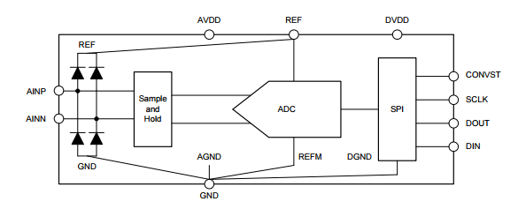
ADS8881
Ti 18-Bit ADC.
Sample Rate: 1MSPS
Input Range: -Vref to Vref or 0 to Vref
High Accuracy, INL: 1LSB
SPI Interface
May 1623 - Low-Cost High-Accuracy Spectral Test System
Project Plan
System Design
Conclusion

Slide 13
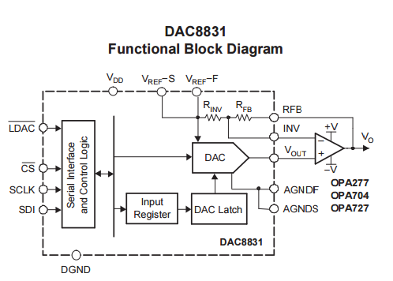
DAC8831
Ti 16-Bit DAC8831. 2.7V to 5.5V single-supply operation
High Accuracy, INL: 1 LSB
SPI Interface
May 1623 - Low-Cost High-Accuracy Spectral Test System
Project Plan
System Design
Conclusion

Slide 14
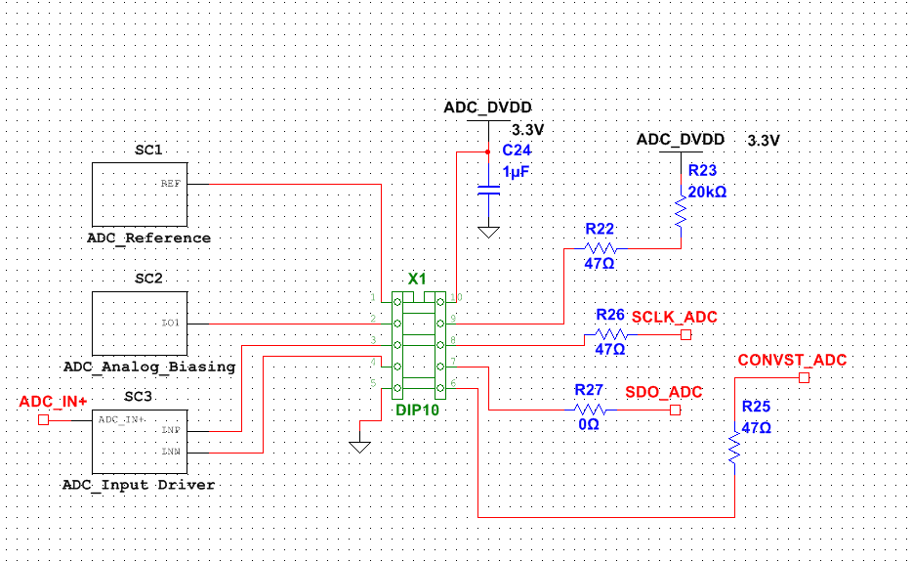
ADC Support Circuit - Top Level ADC
May 1623 - Low-Cost High-Accuracy Spectral Test System
Project Plan
System Design
Conclusion

Slide 15
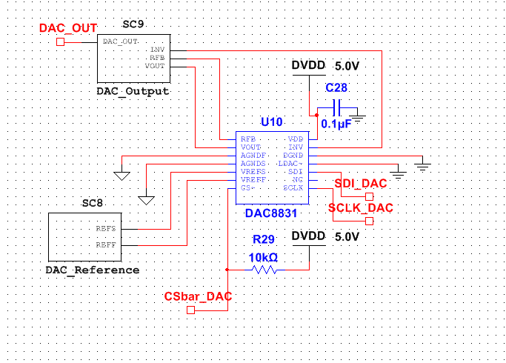
DAC Support Circuit - Top Level DAC
May 1623 - Low-Cost High-Accuracy Spectral Test System
Project Plan
System Design
Conclusion

Slide 16
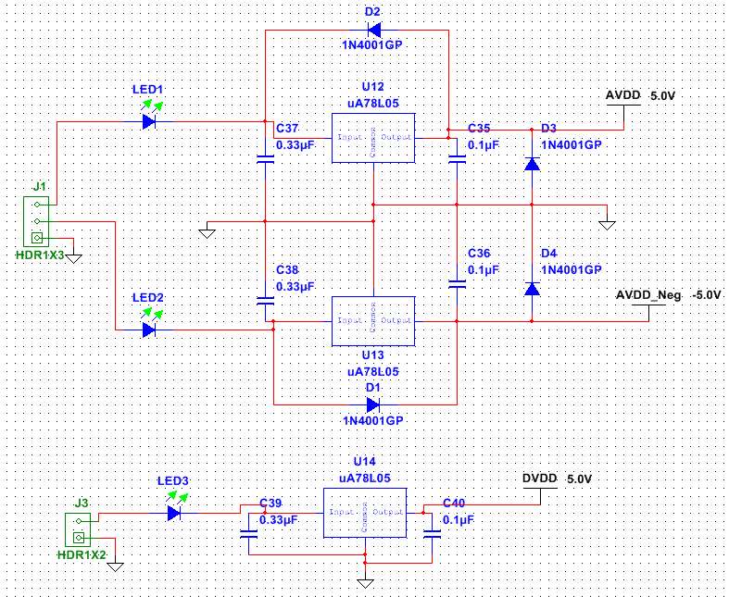
Power Supply
9V from battery
+/- 5V step down from 9V
AVDD & DVDD need to be separated
May 1623 - Low-Cost High-Accuracy Spectral Test System
Project Plan
System Design
Conclusion

Slide 17
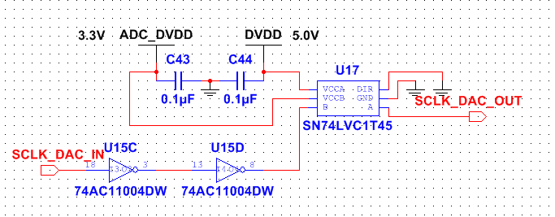
Inverter and Transceiver
May 1623 - Low-Cost High-Accuracy Spectral Test System
Project Plan
System Design
Conclusion

Slide 18
Filter Design - Specifications
Input from DAC: 2.5V sine wave
Output to ADC: 4.3V sine wave
Gain from Input to Output: 1.72
RC Filter and RR Filter: sqrt(2) attenuation at -3dB
Adjusted Gain: 1.72*sqrt(2)
RR Filter
Buffer
Buffer
RC Filter
May 1623 - Low-Cost High-Accuracy Spectral Test System
Project Plan
System Design
Conclusion

Slide 19
Filter Design - Specifications
Center Frequency for Testing: 50kHz
(ADC Sample Rate)/2 = Nyquist Rate
(Nyquist Rate) * 10% = Center Frequency
(1M)/2 = 500k
500k * 10% = 50k
Multiple Sine Waves with Varying Frequencies
Geometric Mean between ~5kHz and ~500kHz
Result: 5k 8.9k 28.3k 50k 88.9k 283k 500k
Adjusted: 4.70k 8.61k 28.70k 46.96k 86.10k 287.00k 469.64k
May 1623 - Low-Cost High-Accuracy Spectral Test System
Project Plan
System Design
Conclusion

Slide 20
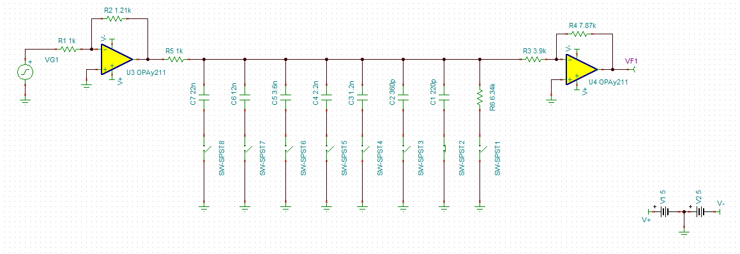
Filter - Simulation (TINA-TI)
May 1623 - Low-Cost High-Accuracy Spectral Test System
Project Plan
System Design
Conclusion

Slide 21
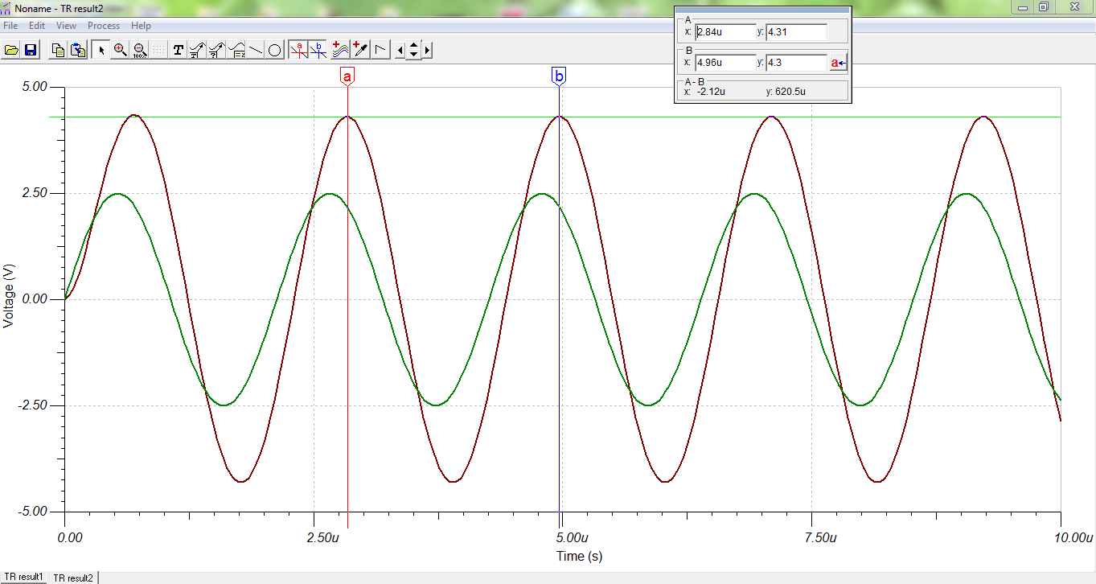
Filter - Simulation (RC Filter)
May 1623 - Low-Cost High-Accuracy Spectral Test System
Project Plan
System Design
Conclusion

Slide 22
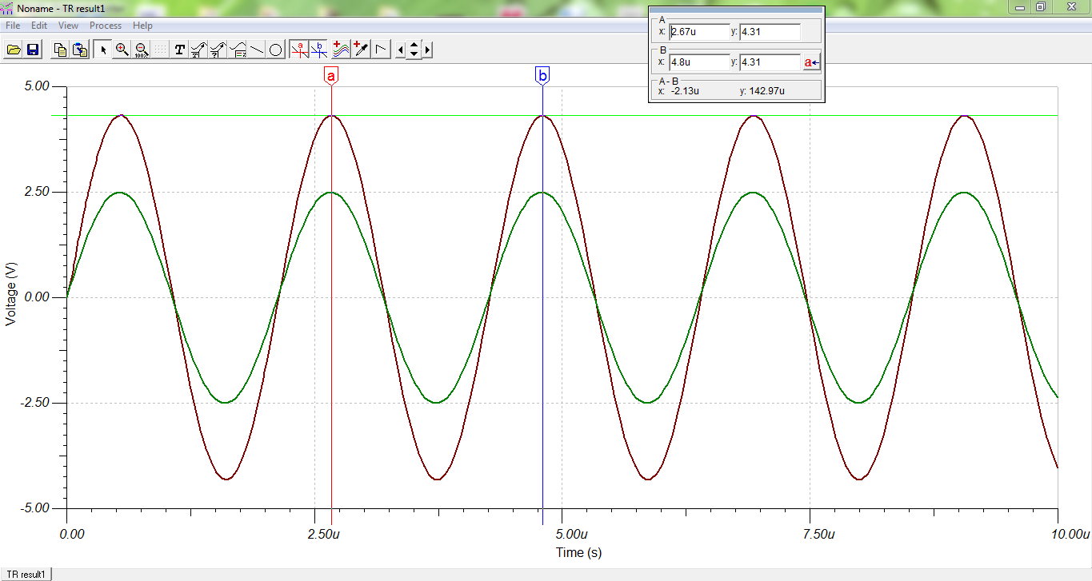
Filter - Simulation (RR Filter)
May 1623 - Low-Cost High-Accuracy Spectral Test System
Project Plan
System Design
Conclusion

Slide 23
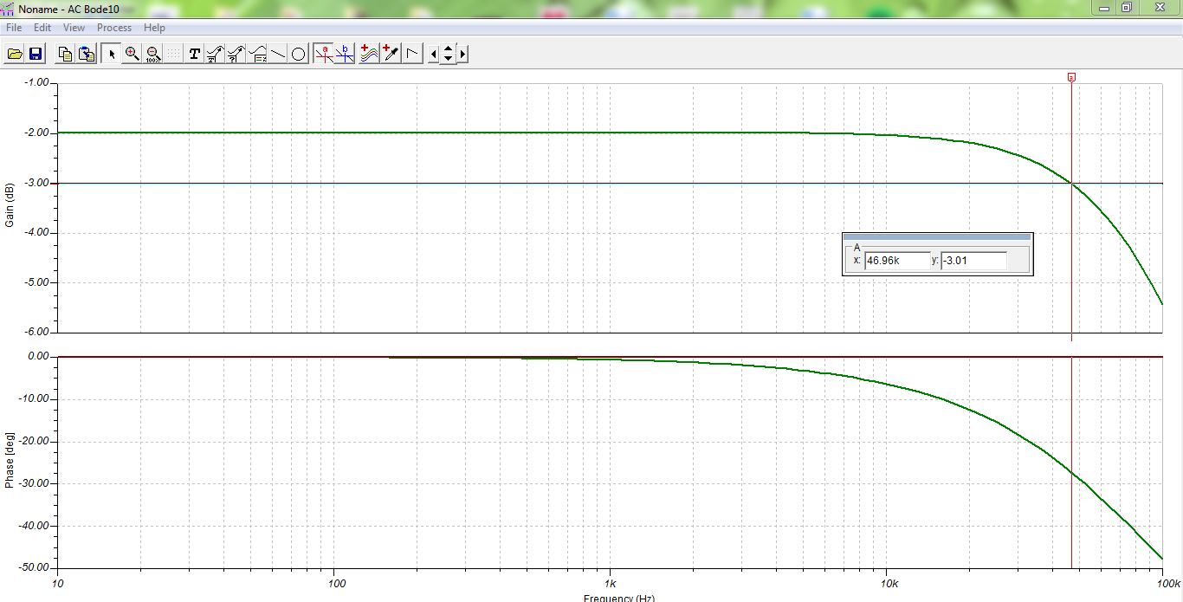
Filter - Simulation (Frequency Response)
RC Filter
RR Filter
May 1623 - Low-Cost High-Accuracy Spectral Test System
Project Plan
System Design
Conclusion

Slide 24
Conclusion
Current Project Status
Task Responsibility
Plan for Next Semester
May 1623 - Low-Cost High-Accuracy Spectral Test System
Project Plan
System Design
Conclusion

Slide 25
Current Project Status
Hardware
Schematic - 95% Complete
BOM - In Progress
PCB Layout - 50% Complete
FPGA Manipulation - In Progress
Timing Diagrams - 25% Complete
Software
2nd Semester Focus
May 1623 - Low-Cost High-Accuracy Spectral Test System
Project Plan
System Design
Conclusion

Slide 26
Task Responsibility
Tao Chen - Team Leader
Yifan Jiang - Team Webmaster
Scott Poder - Team Key Concept Holder
Shared - Creation and Maintence of Weekly Reports/Design Docs/Project Plan
May 1623 - Low-Cost High-Accuracy Spectral Test System
Project Plan
System Design
Conclusion

Slide 27
Plan for Next Semester
Wrap up any unfinished Hardware from previous semester
Order parts from BOM and TI
Build PCB
Test Hardware
Implement software
SPI/Verilog-FPGA/MATLAB/Algorithms
Test Software
Compare Spectral Test Results with Traditional Audio Precision Method
May 1623 - Low-Cost High-Accuracy Spectral Test System
Project Plan
System Design
Conclusion

Slide 28
Questions?
May 1623 - Low-Cost High-Accuracy Spectral Test System
Project Plan
System Design
Conclusion

Slide 29
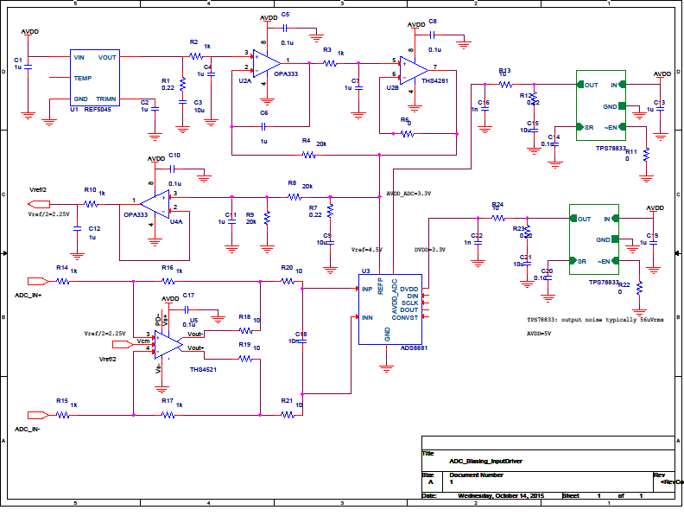
Extra Slides - ADC Driver Circuits

Slide 30
Extra Slides - References
Ben’s Master Thesis:
Magstadt, Benjamin Thomas, "Relaxing the requirements for accurate spectral testing of data converters" (2014). Graduate Theses and Dissertations. Paper 13918.

